Slide 1

Data as a Signal Data X: A Course on Data, Signals, and Systems
Data ^{X}
About Me:
Ikhlaq Sidhu Chief Scientist & Founding Director, Sutardja Center for Entrepreneurship & Technology IEOR Emerging Area Professor Award, UC Berkeley

Slide 2
Outline for Data as a Signal Part I
A Framework
Data as a signal
Means, variances, and windows in time
Linear Time Invariant System Overview (LTI)
Convolution
Filter Examples: Finite Impulse Response, Infinite Impulse Response
Putting it together with a framework and prediction example

Slide 3
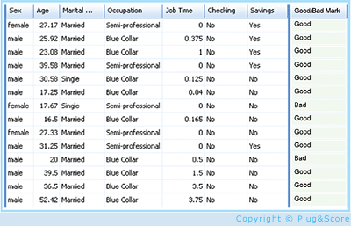
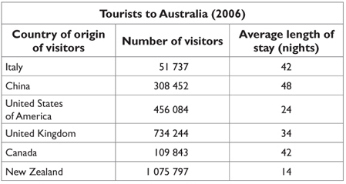
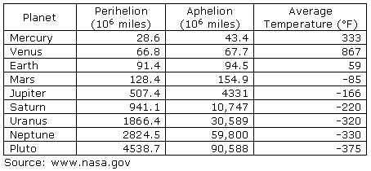
A High Level Framework
Features, but also loss of information
Some data has observed results
In Real Life
Objects
Events/Experiments
People/Customers
Products
Stocks
…
Person 1
Person 2
Person 3
.
.
.
Person N
In Sample
Out of Sample
Characteristics
Patterns
Models
Predictions
Similarities
Differences
Distance

Slide 4
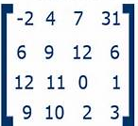
A High Level Framework
Features, but also loss of information
Some data has observed results
In Real Life
Objects
Events/Experiments
People/Customers
Products
Stocks
…
Person 1
Person 2
Person 3
.
.
.
Person N
In Sample
Out of Sample
Characteristics
Patterns
Models
Predictions
Similarities
Differences
Distance
CS: Table
Math: Matrix X, which is
N rows – each person
m columns, each feature (age, salary, ..)
X =

Slide 5
Converting From Time Sequence Data to Features
Of course, not all data has a time property, but lets start with this type.
For example( key1, value 1),( key 2, value 2)… in this case, the keys are indexed by time.

Slide 6
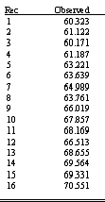
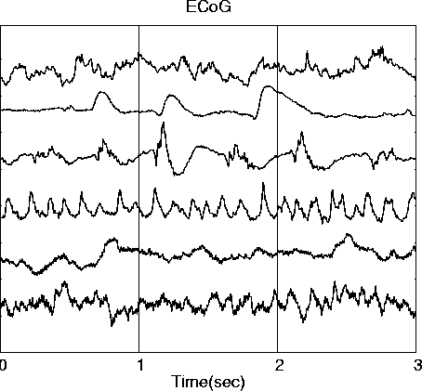
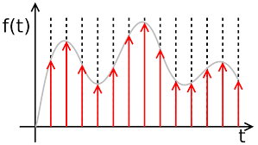
Converting From Time Sequence Data to Features
Many Types of data are signals in time
Stock market
Temperature
Instrument readings
Sometimes we sample them, record at intervals of T
We get a
list in a table, array, or vector
What we want (for now): features and characteristics
For example:
Means
Variances
Patten matches
Changes
accumulation
Frequency
Discrete data
x_{n} = x1, x2, x3, …
Continuous signals
x(t)
Sampled signals (data)
x(nT)
(might lose time reference)

Slide 7
Converting From Time Sequence Data to Features
Many Types of data are signals in time
Stock market
Temperature
Instrument readings
Sometimes we sample them, record at intervals of T
We get a
list in a table, array, or vector
What we want (for now): features and characteristics
For example:
Means
Variances
Patten matches
Changes
accumulation
Frequency
Discrete data
x_{n} = x1, x2, x3, …
Continuous signals
x(t)
Sampled signals (data)
x(nT)
(might lose time reference)

Slide 8
Converting From Time Sequence Data to Features
Many Types of data are signals in time
Stock market
Temperature
Instrument readings
Sometimes we sample them, record at intervals of T
We get a
list in a table, array, or vector
What we want (for now): features and characteristics
For example:
Means
Variances
Patten matches
Changes
accumulation
Frequency
Discrete data
x_{n} = x1, x2, x3, …
Continuous signals
x(t)
Sampled signals (data)
x(nT)
(might lose time reference)

Slide 9
Converting From Time Sequence Data to Features
Many Types of data are signals in time
Stock market
Temperature
Instrument readings
Sometimes we sample them, record at intervals of T
We get a
list in a table, array, or vector
What we want (for now): features and characteristics
For example:
Means
Variances
Patten matches
Changes
accumulation
Frequency
Discrete data
x_{n} = x1, x2, x3, …
Continuous signals
x(t)
Sampled signals (data)
x(nT)
(might lose time reference)

Slide 10
Simple things we can do with a sequence: Mean
Discrete data
x_{n} = x1, x2, x3, …
Mean
Variance
Standard Deviation
But from when, and over what time period

Slide 11
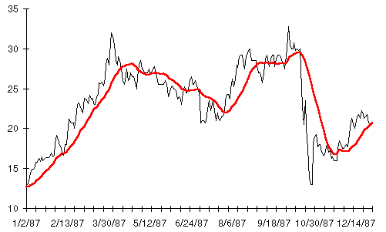
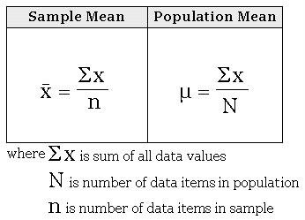
Simple things we can do with a sequence: Mean, Variance
Discrete data x_{n} = x1, x2, x3, …
variance
mean

Slide 12
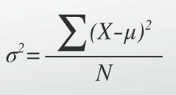
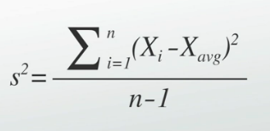
Simple things we can do with a sequence: Mean, Variance
Discrete data
x_{n} = x1, x2, x3, …
variance
mean
And of course, standard deviation is s or sigma

Slide 13
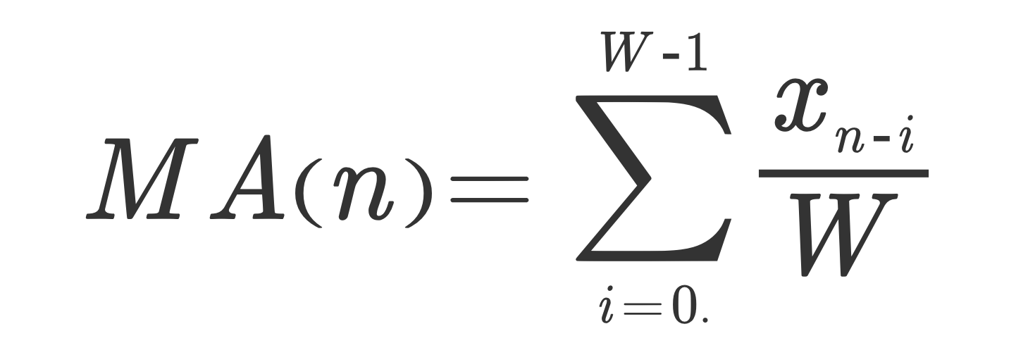
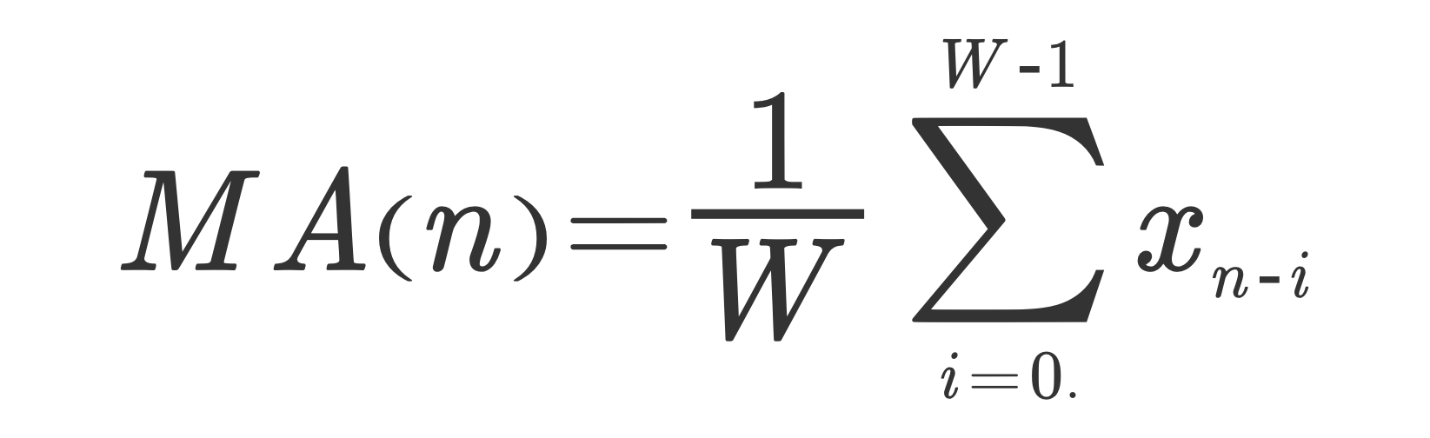
Moving Average of Sequence
(Simple) Moving Average
Discrete data x_{n} = x1, x2, x3, …
Moving Average
W =size of window
MA(n) is red line, at the right edge
of the window
Note:
* It’s a function of n (and maybe W)
* Its smoother than the
original (low pass filter)
W = window size, can be
in the summation
Notes:
The reason we use n-1 rather than n is so that the sample variance will be what is called
an unbiased estimator of the population variance (sigma squared)

Slide 14
LTI Approaches

Slide 15
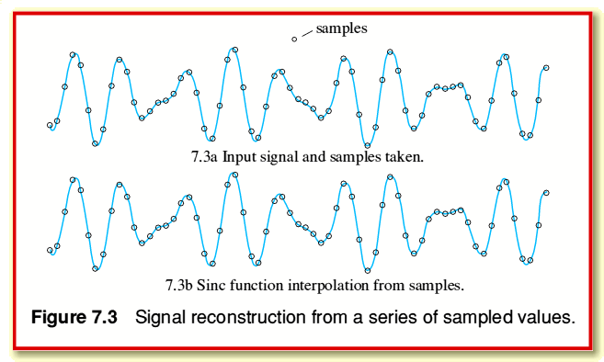
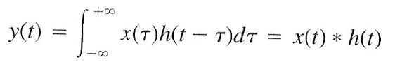
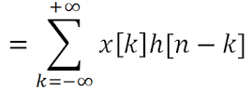
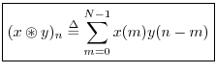
Another Way to Think about Moving Average
x(t)
LTI:
h(n)=1,1,1,1
y[n] is similar to moving average
with window of 4
x(t)
x(n) = array with sequence of numbers = [10, 3, 6, 12, …. … 43, 12, 1, 4]
h(n) = impulse response function from linear systems
= [1, 1, 1, 1]
MA*W = y(n) = x(t) * h(t) (convolution)
Continuous
y[n]
Circular

Slide 16
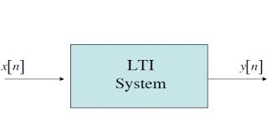
Linear Time Invariant System
x[n]
y[n]
1
1
.5
time
time
0 1 2 3
0 1 2 3
h[n]
1
.5
0 1 2 3
time
Impulse (delta function: area = 1, width -> 0, height -> ∞)
In discrete systems, its just a value of “1”
Impulse response
y[n]
1
x[n]
.5
0.5
.25
0 1 2 3
0 1 2 3

Slide 17
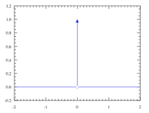
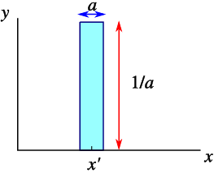
Aside on Delta Functions
x[n]
y[n]
1
1
.5
time
time
0 1 2 3
0 1 2 3
h[n]
1
.5
0 1 2 3
time
Impulse (delta function: area = 1, width -> 0, height -> ∞)
In discrete systems, its just a value of “1”
Impulse response
y[n]
1
x[n]
.5
0.5
.25
0 1 2 3
0 1 2 3

Slide 18
Linear Time Invariant System
x[n]
y[n]
1
1
.5
0 1 2 3
0 1 2 3
h[n]
1
.5
0 1 2 3
Impulse response
y[n]
1
x[n]
.5
0.5
.25
0 1 2 3
0 1 2 3

Slide 19
Convolution is actually really simple, but powerful
y[n] = x[n] * h[n]
x[[n] = 1 2 3 2 4 0 0 0 …
h[n] = 1 1 1
y[n] = 1 1 1
2 2 2
3 3 3
2 2 2
4 4 4
---------------------------------------------
y[n] =1 3 6 7 9 6 4 …
h[n-0] x[0]
h[n-1] x[1]
h[n-2] x[2]
h[n-3] x[1]
h[n-1] x[1]
Note, MA with Window = 3 (if divided by 3)
Note: if h[n] = 1/3, 1/3, 1/3, then y[n] = 1/3, 1, 2, 7/3, 3, 2, 4/3

Slide 20
Another Convolution, different impulse response
y[n] = x[n] * h[n]
x[[n] = 1 2 3 2 4 0 0 0 …
h[n] = 3 2 1
y[n] = 3 2 1
6 4 1
9 6 1
6 4 1
12 8 4
---------------------------------------------
y[n] =3 8 14 13 17 9 4 …
h[n-0] x[0]
h[n-1] x[1]
h[n-2] x[2]
h[n-3] x[1]
h[n-1] x[1]
This is called filtering the data with an FIR filter with impulse response h[n] = 3 2 1

Slide 21
Code Example of Convolution
>>> np.convolve([1, 2, 3], [0, 1, 0.5])
array([ 0. , 1. , 2.5, 4. , 1.5])
numpy.convolve(a, v, mode='full')[source]
Returns the discrete, linear convolution of two one-dimensional sequences.
The convolution operator is often seen in signal processing, where it models the effect of a linear time-invariant system on a signal [R17]. In probability theory, the sum of two independent random variables is distributed according to the convolution of their individual distributions.
Notes:
The discrete convolution operation is defined as
(a * v)[n] = \sum_{m = -\infty}^{\infty} a[m] v[n - m]
It can be shown that a convolution x(t) * y(t) in time/space is equivalent to the multiplication X(f) Y(f) in the Fourier domain, after appropriate padding (padding is necessary to prevent circular convolution). Since multiplication is more efficient (faster) than convolution, the function scipy.signal.fftconvolve exploits the FFT to calculate the convolution of large data-sets.

Slide 22
Convolution: why we care
Take Any Input Sequence x[n]
Filter for what you want with h[n]
Get result y[n]
FIR:
Finite Impulse
Response Filter
h[n] Result
1/W,1/W,1/W,1/W Low pass filter or moving average, with 1/W cutoff
(a1,a2,…a10) Any linear weighted sum
1, -1 Differential
Any sequence Cross-correlation, allows you to look for similar pattern

Slide 23
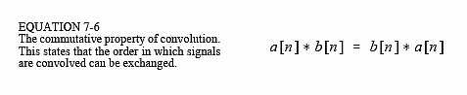
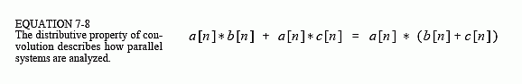
Properties of Convolution

Slide 24
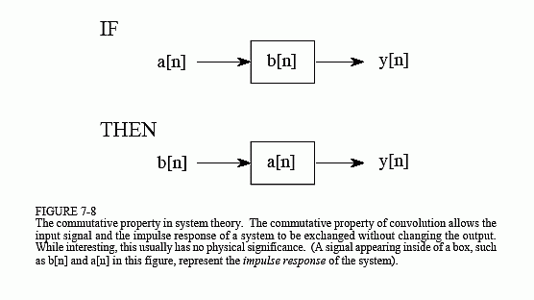

Slide 25
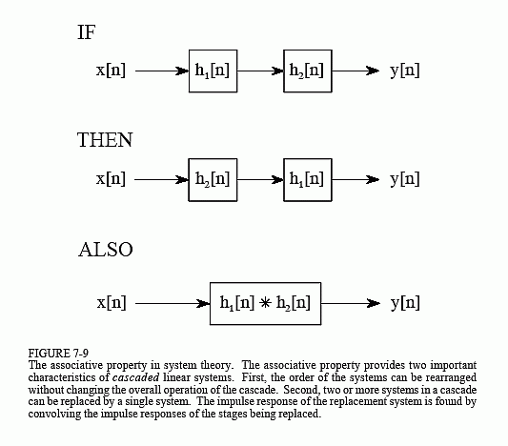

Slide 26
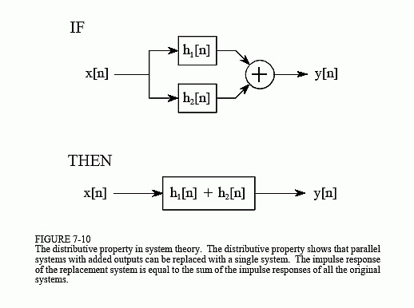

Slide 27
FIR Code Example with Convolution

Slide 28


Another LTI System
Discrete data x_{n} = x1, x2, x3, …
Another LTI System
x[n]
a
+
y[n]
Delay 1 (1-a)
alpha = smoothing factor of 2/(W+1)
W is number of time periods
Infinitely back in x[n]
W =size of window
mean
Notes:
An exponential moving average (EMA) is a type of moving average that is similar to a simple moving average, except that more weight is given to the latest data. It's also known as the exponentially weighted moving average. This type of moving average reacts faster to recent price changes than a simple moving average.

Slide 29
Another LTI System:
Discrete data x_{n} = x1, x2, x3, …
Another LTI System
x[n]
a
+
y[n]
Delay 1 (1-a)
Exponential Moving Average
alpha = smoothing factor of 2/(W+1)
W is number of time periods
Infinitely back in x[n]
IIR:
Infinite Impulse
Response Filter
W =size of window
mean
Notes:
An exponential moving average (EMA) is a type of moving average that is similar to a simple moving average, except that more weight is given to the latest data. It's also known as the exponentially weighted moving average. This type of moving average reacts faster to recent price changes than a simple moving average.

Slide 30
IIR Code Example with Convolution

Slide 31
Example in Quant Finance
Stock Prices
appl[n]
fb[n]
goog[n]
n = today, n-1 = yesterday, etc.
Convert to this form, rows = companies, columns = features
 | Price | Price[n-30] | 20 day MA | 1 year average | Expected Price?
APPL | appl[n] | appl[n-20] | appl*h_20 | appl_1y()
FB | fb[n] | fb[n-20] | fb*h_20 | fb_1y()
GOOG | goog[n] | goog[n-20] | goog*h_20 | goog_1y()

Slide 32
What could stock FB be priced today?
Group_Average_1 year
= (FB_1YearAve + GOOG_1YearAve + AAPL_1YearAve)/3
Group_Average_today[n] = (fb[n]+goog[n]+aapl[n])/3
Today’s price could be predicted as the same ratio as over the past year:
FB-1 year FB-today
------------ = ------------
Group-1 year group today
fb_exp[n] = Group_Average_today * fb[n]/Group_Average_1 year
goog_exp[n] = Group_Average_today * goog[n]/Group_Average_1 year
Apple_exp[n] = Group_Average_today * aapl[n]/Group_Average_1 year
Difference [n] = fb[n] – fb_exp[n]

Slide 33
Example in Quant Finance: Limits of LTI Systems
Stock Prices: appl[n], fb[n], goog[n]
n = today, n-1 = yesterday, etc.
 | Price | Price[n-30] | 1 year average | median | Expected Price today[n]
APPL | appl[n] | appl[n-20] | appl_1y() | appl_med() | appl-exp[n]
FB | fb[n] | fb[n-20] | fb_1y() | fb_med() | fb-exp[n]
GOOG | goog[n] | goog[n-20] | goog_1y() | goog_md() | goog-exp[n]
These features can be
Calculated by LTI systems
These are not, eg. median and many others

Slide 34
Example in Quant Finance: Training on the past
Stock Prices: appl[n], fb[n], goog[n]
n = today, n-1 = yesterday, etc.
Now try with n’ = n-60 ( 3 months ago)
 | Price[n’] | Expected Price today[n’] | Price at n’+60 How did it turn out
APPL | appl[n] | appl-exp[n] | +10% | Error?
FB | fb[n] | fb-exp[n] | +15% | Error?
GOOG | goog[n] | goog-exp[n] | -5% | Error?
You could train on the last quarter to know how well the algorithm does
More on that later

Slide 35
Code Example and Homework

Slide 36
Summary: Time Varying Data Signals to Features
Features, but also loss of information
In Real Life
Objects
Events/Experiments
People/Customers
Products
Stocks
…
Person 1
Person 2
Person 3
.
.
.
Person N
In Sample
Out of Sample
Time Varying Signals to Features
Characteristics
Patterns
Models
Predictions
Similarities
Differences
Distance
CS: Table
Math: Matrix X, which is
N rows – each person
m columns, each feature (age, salary, ..)

Slide 37
End of Section

Slide 38
Pandas

Slide 39
BTW, What is Pandas? It has an object called a Data Frame which is like a table
Wes Mckinney

Slide 41
Code Example in Python Notebook Get Stock Data Use Pandas to get a CSV format Slice the Table Convert to Numpy Array Format Sample Numpy and Pandas Operations
Notebook: 2a - Pandas Overview

